Slide 1

Tallahassee Crime Map
Project Proposal
Mao Nishino

Slide 2
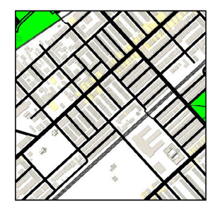
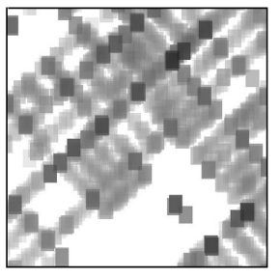
Project At A Glance
Goal: Develop a generative AI that outputs a crime distribution given a geographical map.
Why: To provide a tool for city planners to see potential crime risks with their plans.
Technology: Generative Adversarial Network (pix2pix)
Image from He & Zheng (2021)

Slide 3

Generative Adversarial Network
Two Neural Networks: Generator (G) and Discriminator (D)
Actual sample
D
$P($the sample is not fake)
G
Random noise
Fake sample
In the training, G and D try to beat each other (hence the word “adversarial”)
The training stops when D can no longer discriminate fake samples

Slide 4
Generative Adversarial Network
The outcome of the training: The G network
We can use G to create fake samples that look identical to actual samples.
G
Random noise
Fake sample

Slide 5
Conditional GAN (Pix2pix)
What do we do if we want a G network that takes a geographical map and outputs a crime map?
Actual sample
D
$P($the sample is not fake)
G
Random noise
Fake sample

Slide 6
Conditional GAN (Pix2pix)
What do we do if we want a G network that takes a geographical map and outputs a crime map?
Actual sample
D
$P($the sample is not fake)
G
Fake sample
Actual map

Slide 7
Conditional GAN (Pix2pix)
What do we do if we want a G network that takes a geographical map and outputs a crime map?
Actual sample
D
$P($the sample is not fake)
G
Actual map
Fake crime map

Slide 8
Conditional GAN (Pix2pix)
What do we do if we want a G network that takes a geographical map and outputs a crime map?
Actual sample
D
$P($the sample is not fake)
G
Actual map -
fake crime map
pair
Actual map
Fake crime map

Slide 9
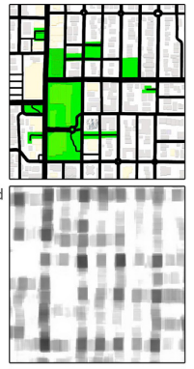
Conditional GAN (Pix2pix)
What do we do if we want a G network that takes a geographical map and outputs a crime map?
Actual map
- actual crime map
pair
D
$P($the sample is not fake)
G
Actual map -
fake crime map
pair
Actual map
Fake crime map

Slide 10
Conditional GAN (Pix2pix)
After training, a crime map generator is born.
G
Actual map
Fake crime map

Slide 11
Team Structure
Abdullah Malik
Team A
Çağatay Ayhan
Ece Karaçam
Team B
Abdullah Malik
Munawar Ali
Management/Support
Mao Nishino

Slide 12
Rough plan
Week | Team A | Team B
Today-Feb 1 | Learn Git -> Understand how pix2pix and Geopandas works (everyone) Data Collection (Mao)
Week 1 (Feb 1-) | EDA using Geopandas/Sklearn | Creating Heatmap
Week 2 | EDA using Geopandas/Sklearn | Creating Heatmap
Week 3 | EDA using Geopandas/Sklearn | Creating Heatmap
Week 4 | Present the EDA result | Implement/Train pix2pix
Week 6 | Implement/Train pix2pix | Implement/Train pix2pix
Week 7 | Use the model to plan a better Tallahassee | Use the model to plan a better Tallahassee
Week 8 | Prepare Presentation | Prepare Presentation
Update the plan

Slide 13
Next Steps
Learn how to use Git/GitHub in a team setting
Basics(commit, branches, pull requests)
Learn how to use pix2pix
Update the plans in week 3-6 (we need a more detailed plan/how to split the workload)
Detailed information should be available in the project repository.

Slide 14
Thank you
Mao Nishino
mnishino@math.fsu.edu

